Slide 1
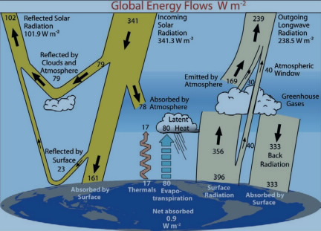
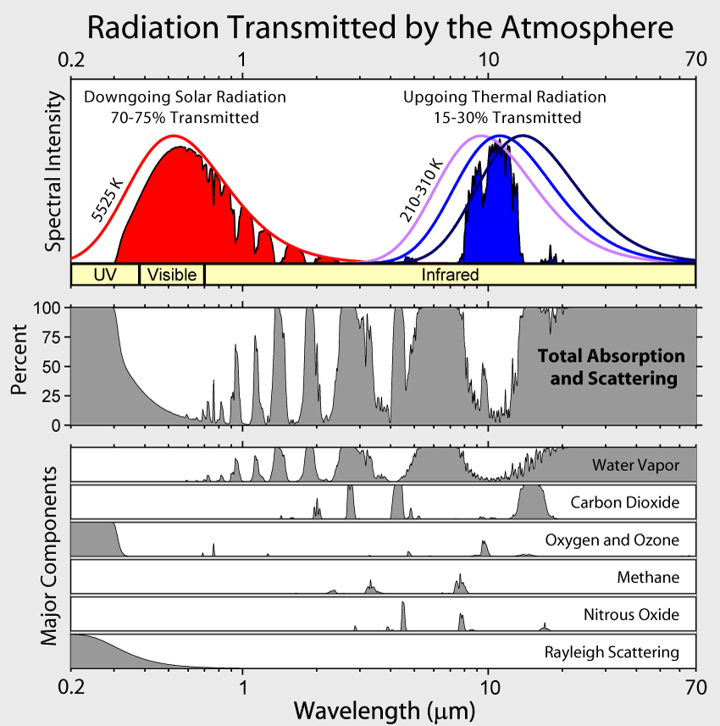
Photolysis of O₂ leading to ozone creation
Ozone creation is a two-step process called the Chapman Mechanism

Slide 2
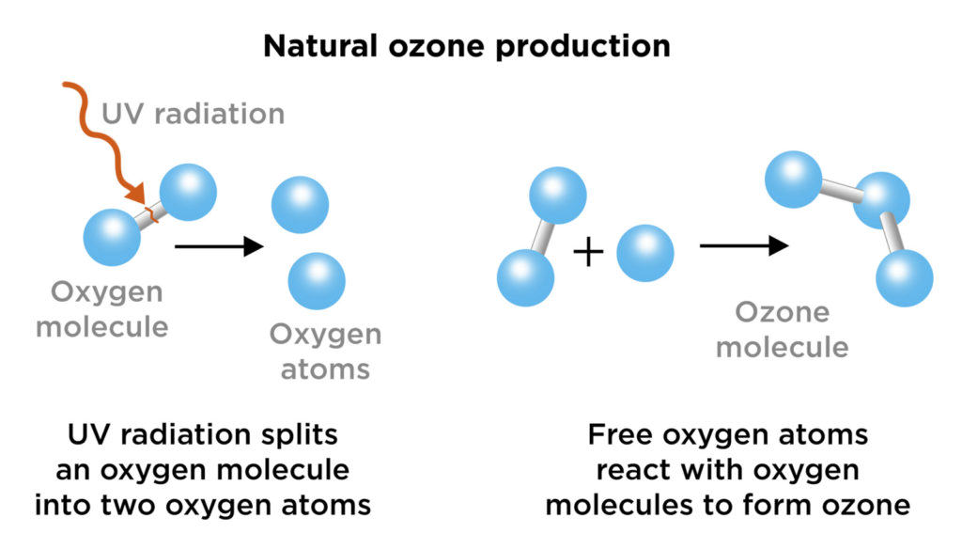


Chapman Mechanism
Step 1: Photolysis
Step 2: Combination
Chemical equations
$$O_{2}+hν→2O$$
$$O_{2}+O→O_{3}$$

